Slide 1

6th Grade Accelerated Math
Unit 3, Lesson 7 Absolute Value Volume 1, pg. 111

Slide 2


Benchmark
MA.6.NSO.1.3
Given a mathematical or real-world context, interpret the absolute value of a number as the distance from zero on a number line. Find the absolute value of rational numbers.
volume 1, pg. 111

Slide 3
Integrated Mathematical Thinking and Reasoning Standards
MA.K12.MTR.2.1 Demonstrate understanding by representing problems in multiple ways.
MA.K12.MTR.5.1 Use patterns and structure to help understand and connect mathematical concepts.
MA.K12.MTR.7.1 Apply mathematics to real-world contexts.
volume 1, pg. 111

Slide 4

Learning Targets
I can find the absolute value of a rational number.
I can find the absolute value of a value and interpret it within the context.
volume 1, pg. 111

Slide 5

Warm-Up
volume 1, pg. 111

Slide 6
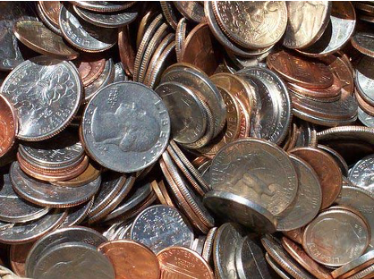
3.7.1 Warm-Up: Would You Rather?
Would you rather have Pile A or Pile B? Justify your reasoning.
Pile A | Pile B
14 pennies | 2 pennies
7 nickels | 4 nickels
2 dimes | 2 dimes
1 quarter | 2 quarters
volume 1, pg. 111

Slide 7

Exploration
volume 1, pg. 112

Slide 8

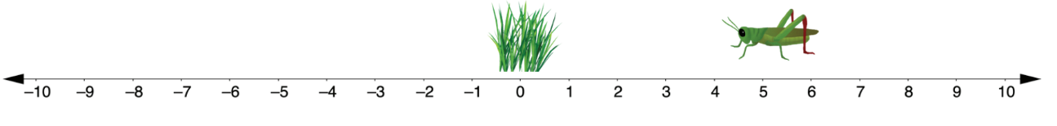
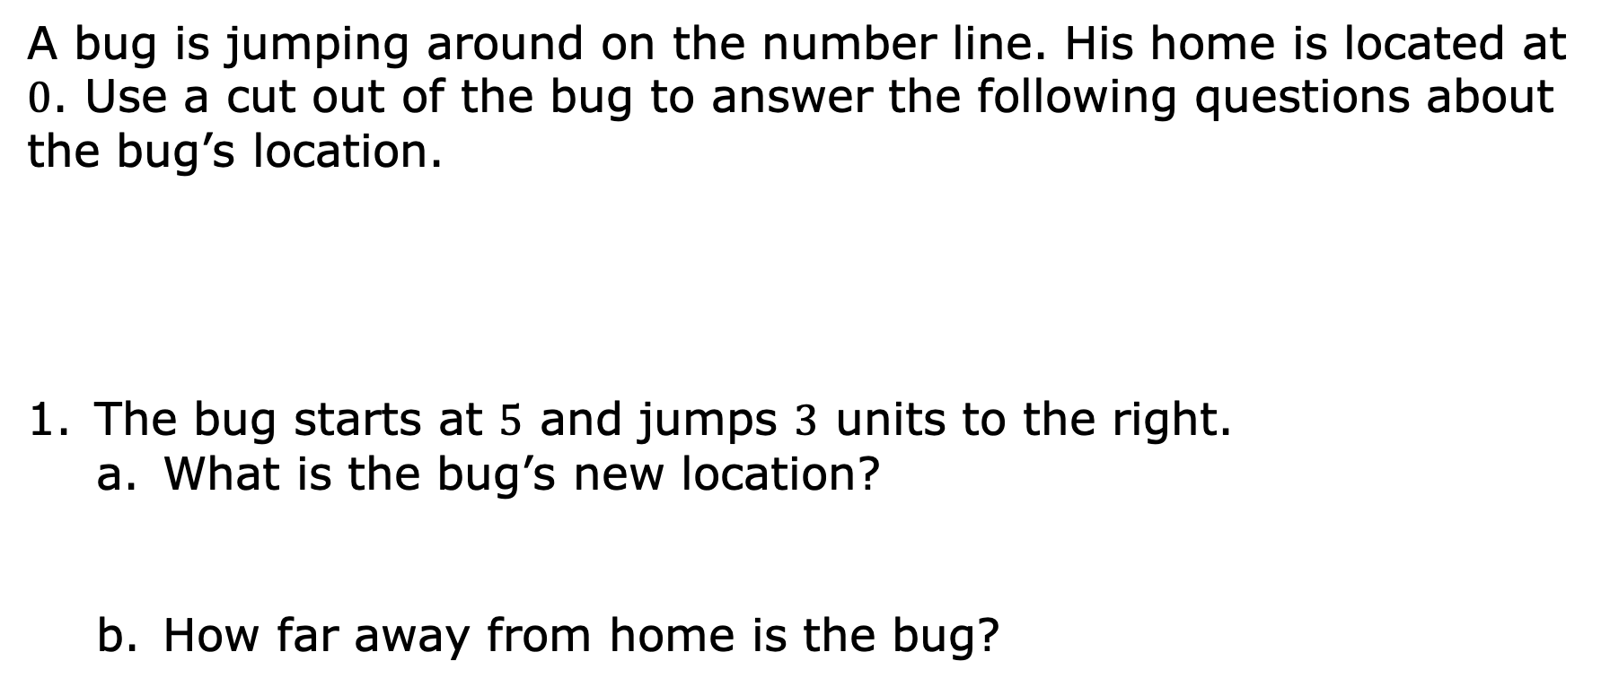
3.7.2 Exploration: Jumping Bugs
A bug is jumping around on the number line. His home is located at $0$. Use a cut out of the bug to answer the following questions about the bug’s location.
The bug starts at $5$ and jumps $3$ units to the right.
What is the bug’s new location?
How far away from home is the bug?
volume 1, pg. 112

Slide 9
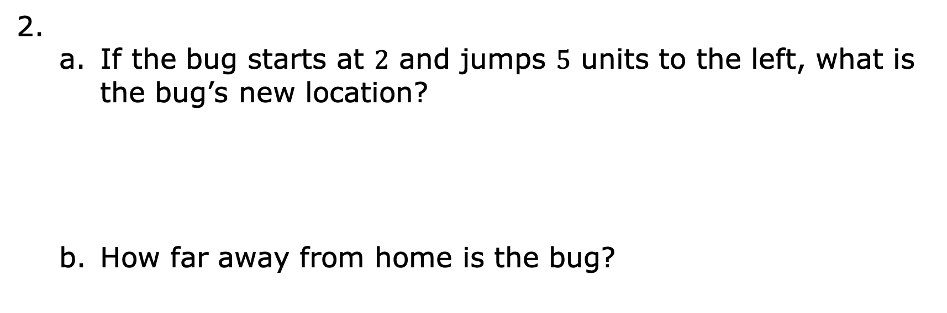
If the bug starts at $2$ and jumps $5$ units to the left, what is the bug’s new location?
How far away from home is the bug?
volume 1, pg. 112

Slide 10
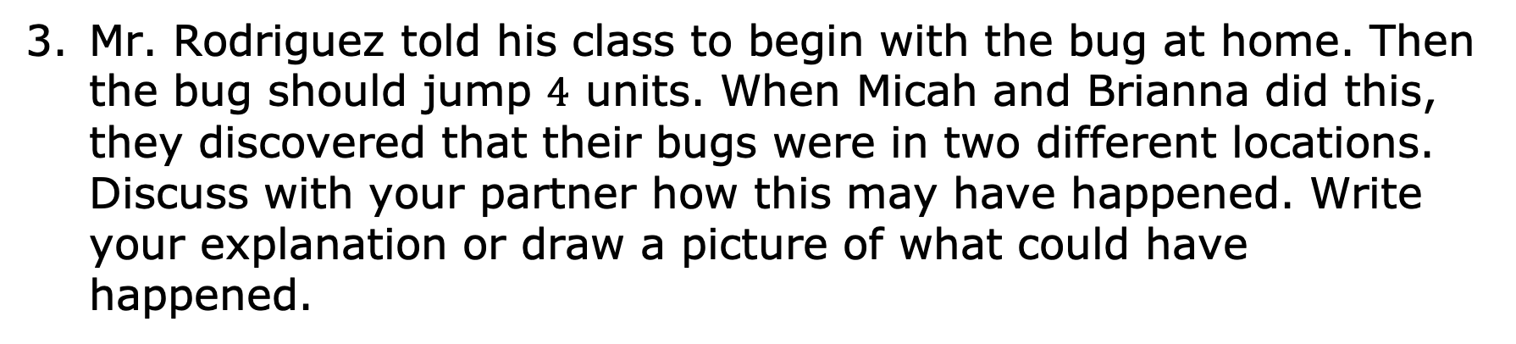
Mr. Rodriguez told his class to begin with the bug at home. Then the bug should jump $4$ units. When Micah and Brianna did this, they discovered that their bugs were in two different locations. Discuss with your partner how this may have happened. Write your explanation or draw a picture of what could have happened.
volume 1, pg. 112

Slide 11

Guided Instruction
volume 1, pg. 113

Slide 12

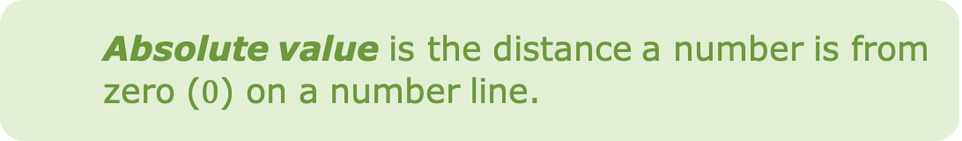
3.7.3 Guided Instruction: Absolute Value and Zero
Recall how opposite numbers relate to zero. Complete the explanation below by writing a word in each blank.
Pairs of opposite values are the same ______________ from zero on the number line. They are mirror images of each other, with a line of symmetry through __________.
Absolute value is the distance a number is from zero ($0$) on a number line.
volume 1, pg. 113

Slide 13

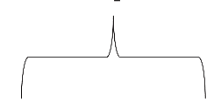
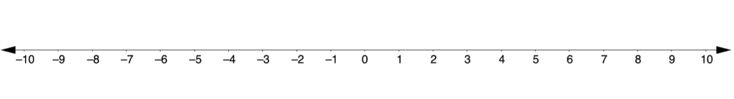
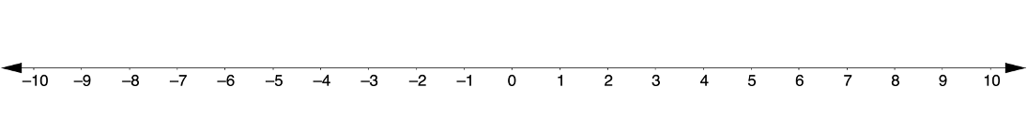
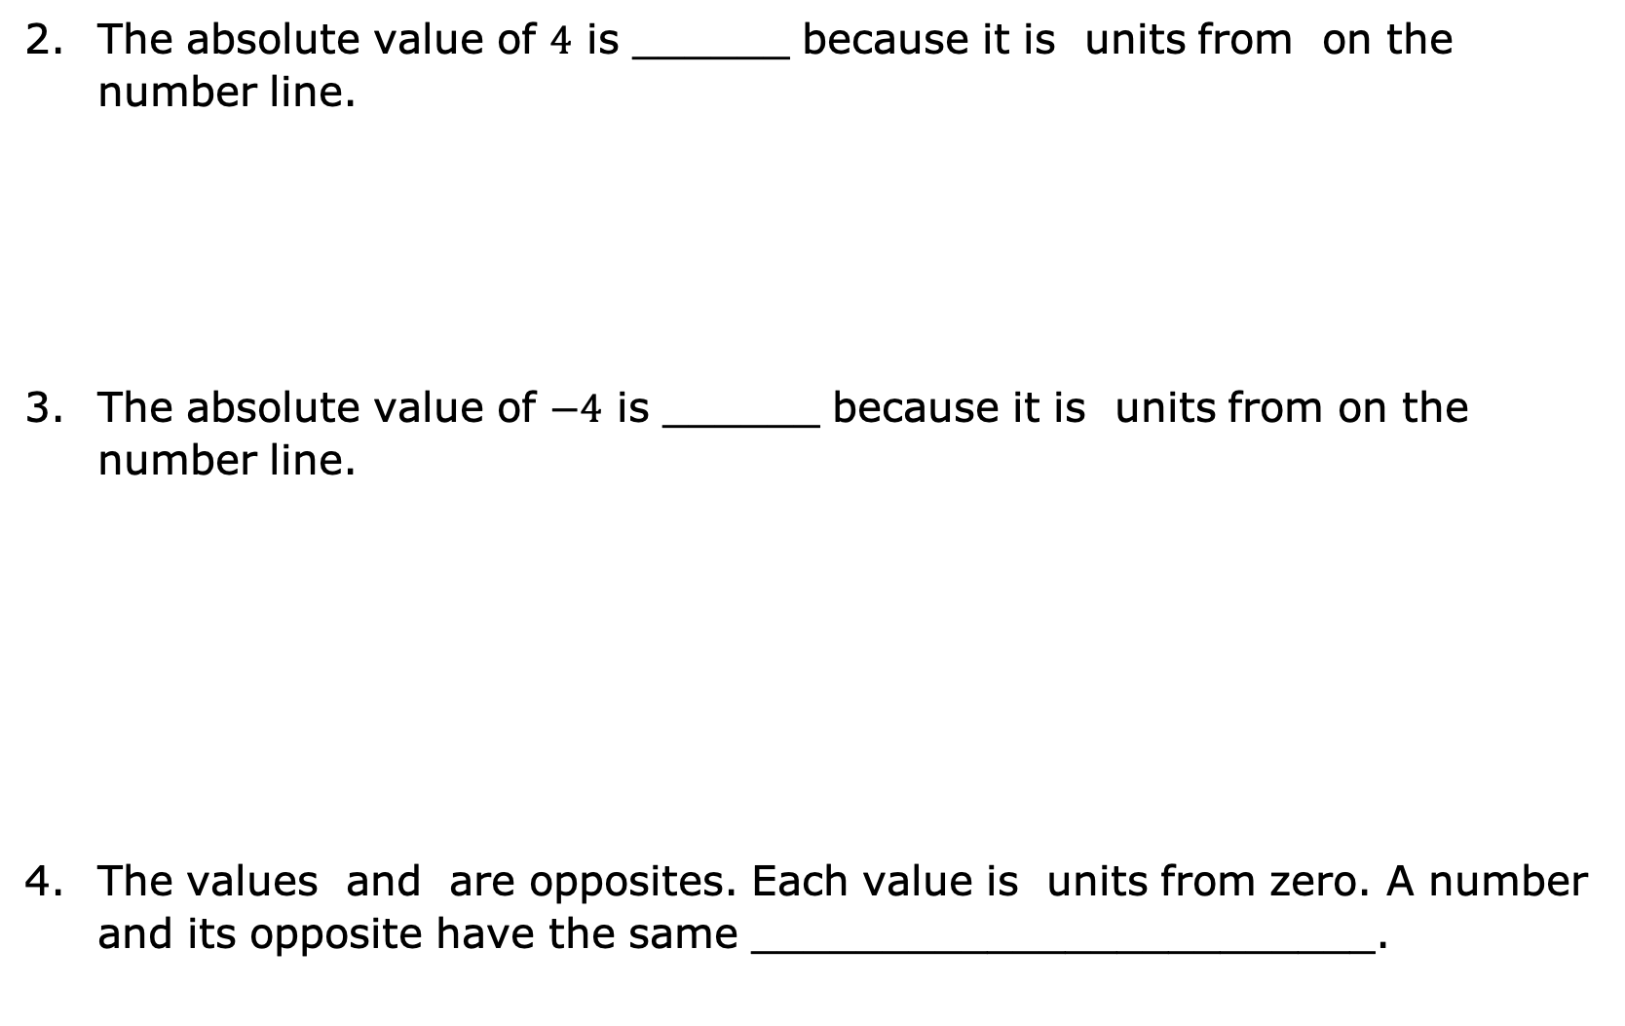
The absolute value of $4$ is ______ because it is units from on the number line.
The absolute value of $−4$ is ______ because it is units from on the number line.
The values and are opposites. Each value is units from zero. A number and its opposite have the same ________________________.
volume 1, pg. 113

Slide 14

Guided Practice
volume 1, pg. 113

Slide 15

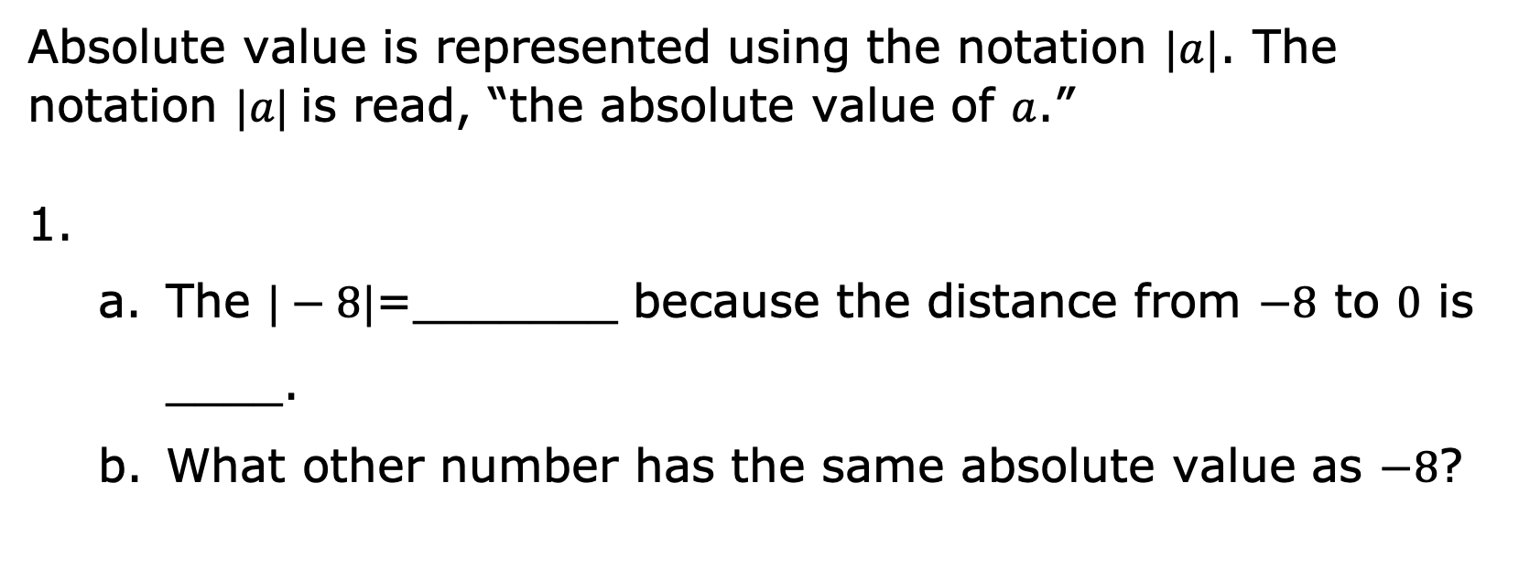
3.7.4 Guided Practice: Absolute Value and Zero
Absolute value is represented using the notation $|a|$. The notation $|a|$is read, “the absolute value of $a$.”
The $|−8|$=_______ because the distance from $−8$ to $0$ is ____.
What other number has the same absolute value as $−8$?
volume 1, pg. 113

Slide 16

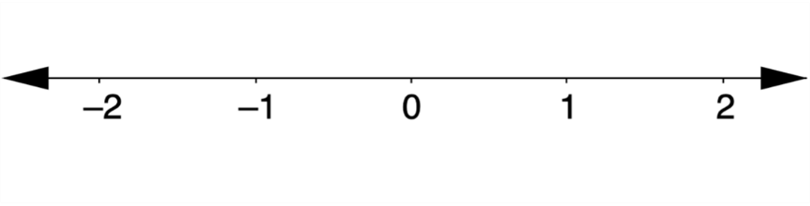
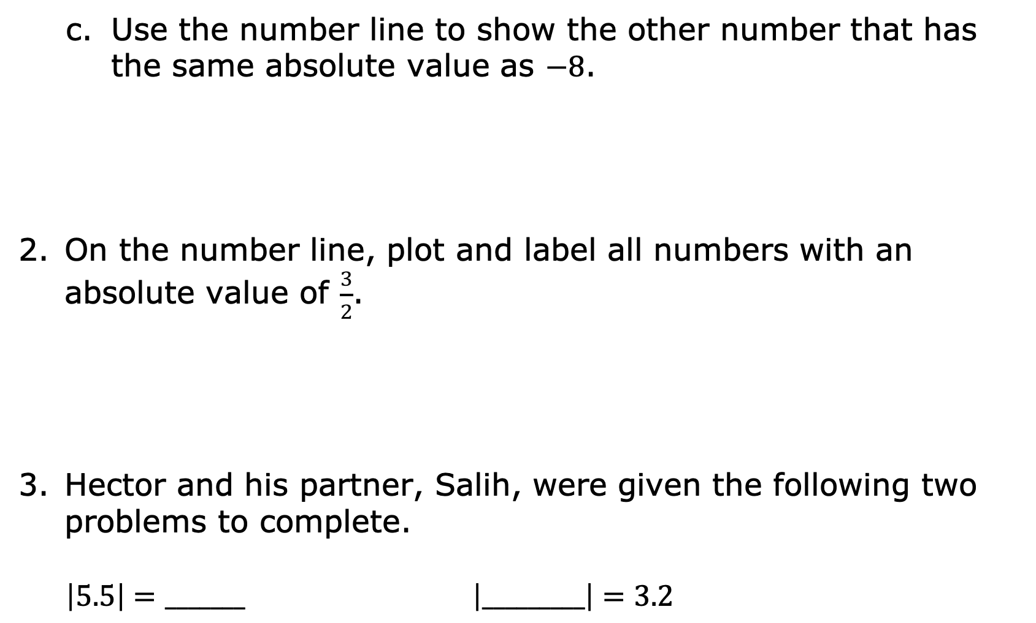
Use the number line to show the other number that has the same absolute value as $−8$.
On the number line, plot and label all numbers with an absolute value of $\frac{3}{2}$.
Hector and his partner, Salih, were given the following two problems to complete.
$\left|5.5\right|=_______$ $\left|_________\right|=3.2$
volume 1, pg. 113

Slide 17
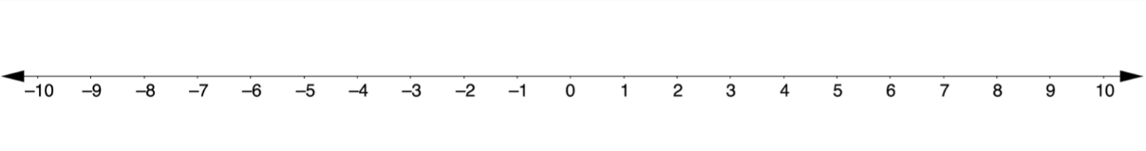
Hector and Salih had the same answer for one of the blanks but two different answers for the other. Their teacher told them they both had the correct answers.
Which problem can have more than one correct answer?
Use the number line to explain how this is possible.
volume 1, pg. 114

Slide 18

Collaboration
volume 1, pg. 114

Slide 19

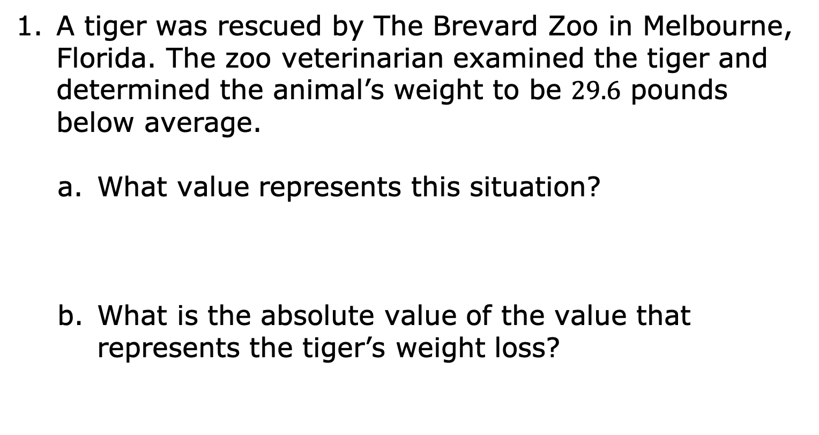
3.7.5 Collaboration: Absolute Value and Opposites in the Real World
A tiger was rescued by The Brevard Zoo in Melbourne, Florida. The zoo veterinarian examined the tiger and determined the animal’s weight to be $29.6$ pounds below average.
What value represents this situation?
What is the absolute value of the value that represents the tiger’s weight loss?
volume 1, pg. 114

Slide 20
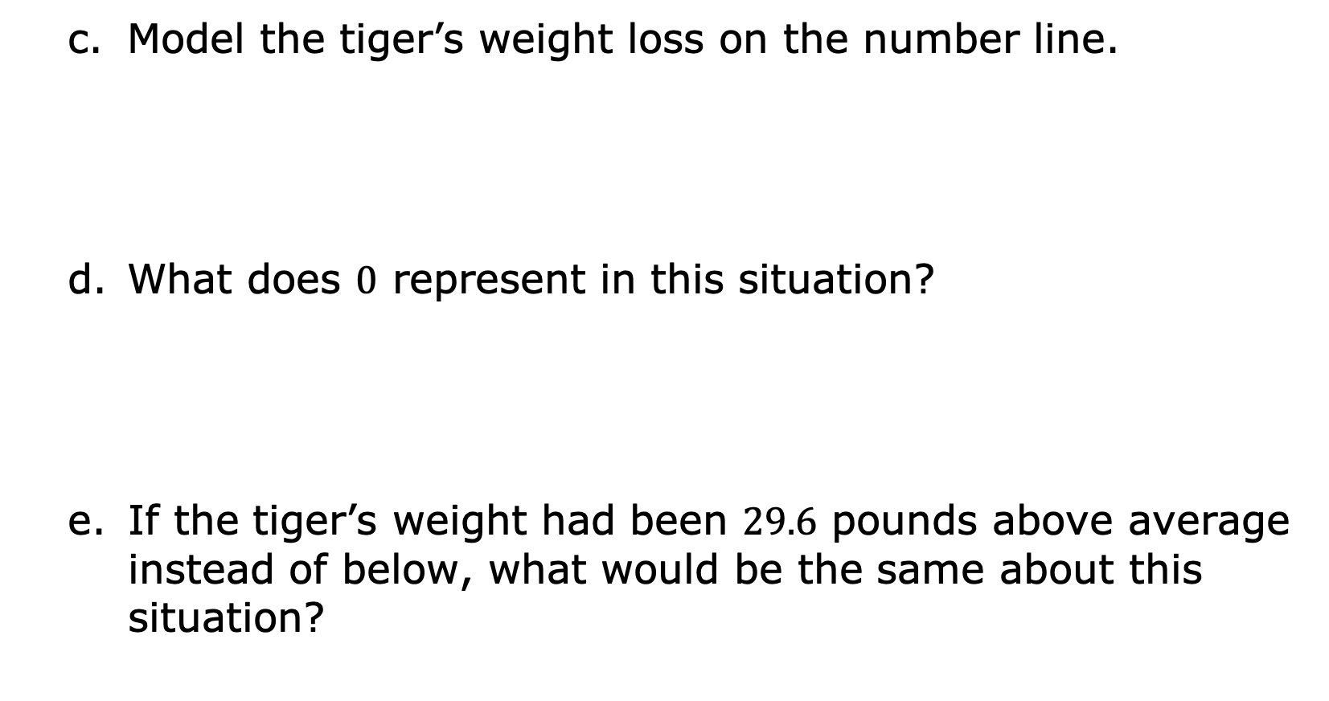
Model the tiger’s weight loss on the number line.
What does $0$ represent in this situation?
If the tiger’s weight had been $29.6$ pounds above average instead of below, what would be the same about this situation?
volume 1, pg. 114

Slide 21
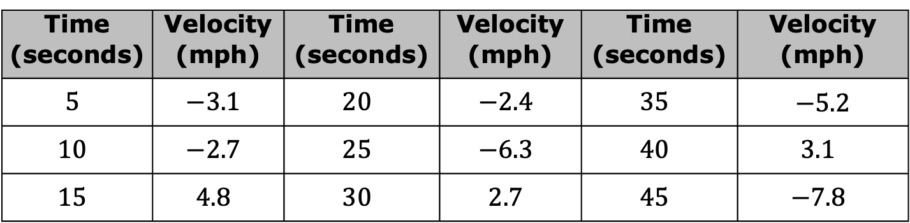
Simone is doing research on different rides at the Strawberry Festival. She attaches an accelerator to a bumper car to measure the velocity of her car. She recorded the velocities, in miles per hour (mph), in the table.
Speed is the absolute value of velocity.
Time (seconds) | Velocity (mph) | Time (seconds) | Velocity (mph) | Time (seconds) | Velocity (mph)
$$5$$ | $$−3.1$$ | $$20$$ | $$−2.4$$ | $$35$$ | $−5.2$
$$10$$ | $$−2.7$$ | $$25$$ | $$−6.3$$ | $$40$$ | $$3.1$$
$$15$$ | $$4.8$$ | $$30$$ | $$2.7$$ | $$45$$ | $$−7.8$$
volume 1, pg. 115

Slide 22
Determine when the bumper car is at the same speed. List the times and the speed of the car at those times.
At what time is the bumper car traveling at the slowest speed?
At what time is the bumper car traveling at the fastest speed?
volume 1, pg. 115

Slide 23
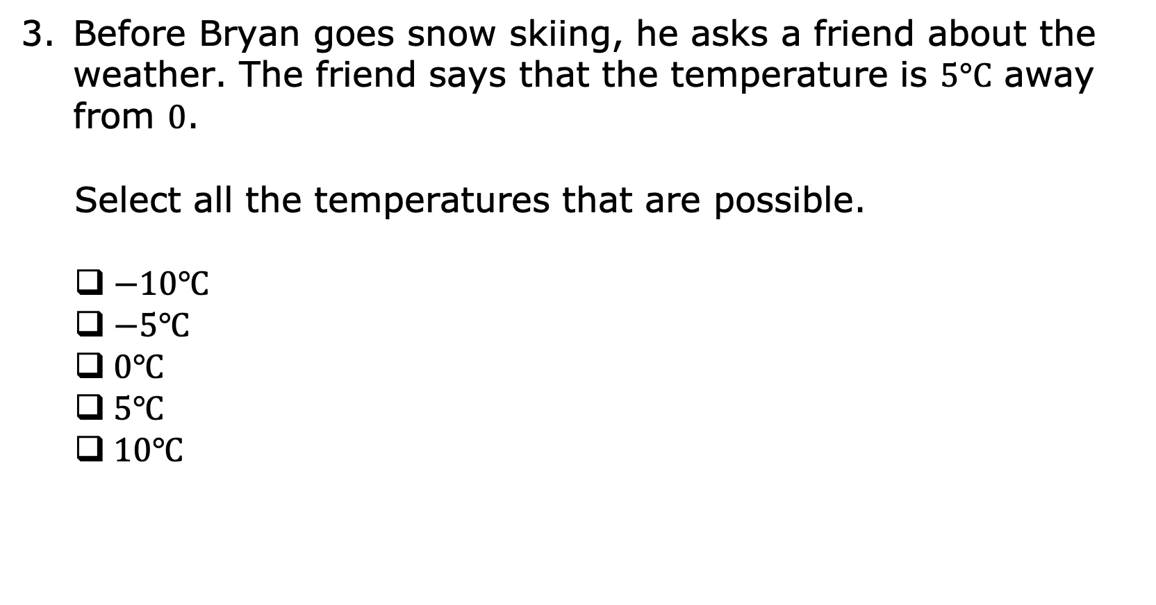
Before Bryan goes snow skiing, he asks a friend about the weather. The friend says that the temperature is $5°C$ away from $0$.
Select all the temperatures that are possible.
$−10℃$
$−5℃$
$0℃$
$5℃$
$10℃$
volume 1, pg. 115

Slide 24
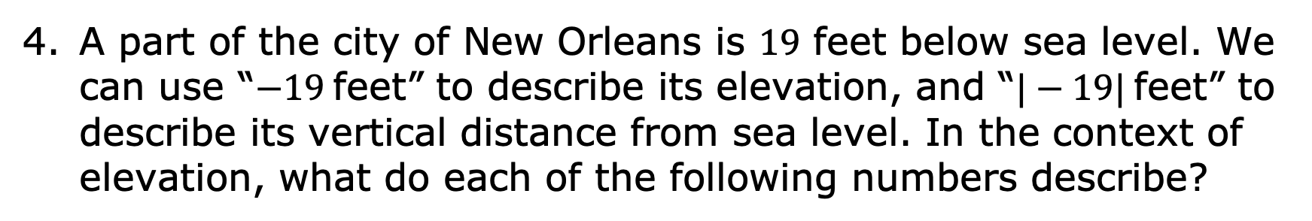
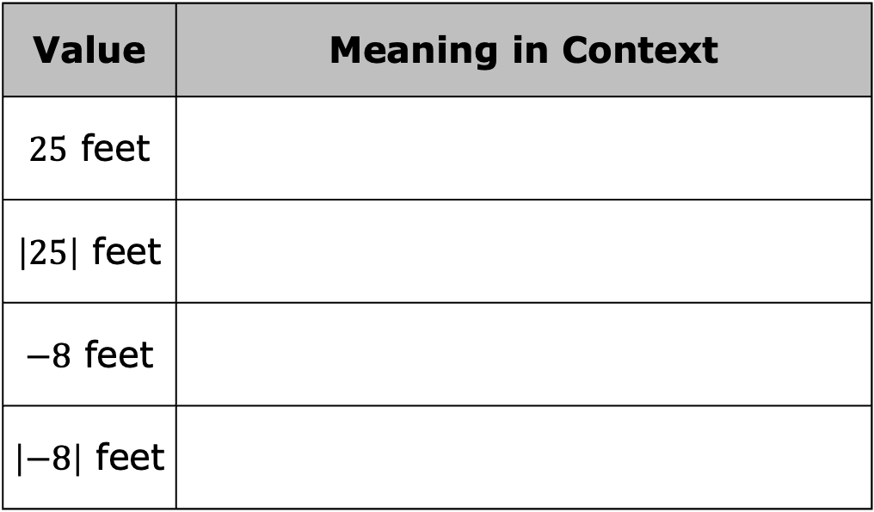
A part of the city of New Orleans is $19$ feet below sea level. We can use “$−19$feet” to describe its elevation, and “$|−19|$feet” to describe its vertical distance from sea level. In the context of elevation, what do each of the following numbers describe?
Value | Meaning in Context
$25$ feet
$\left|25\right|$ feet
$−8$ feet
$\left|−8\right|$ feet
volume 1, pg. 115

Slide 25

Your Turn
volume 1, pg. 116

Slide 26
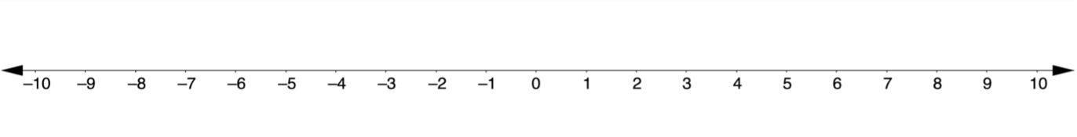
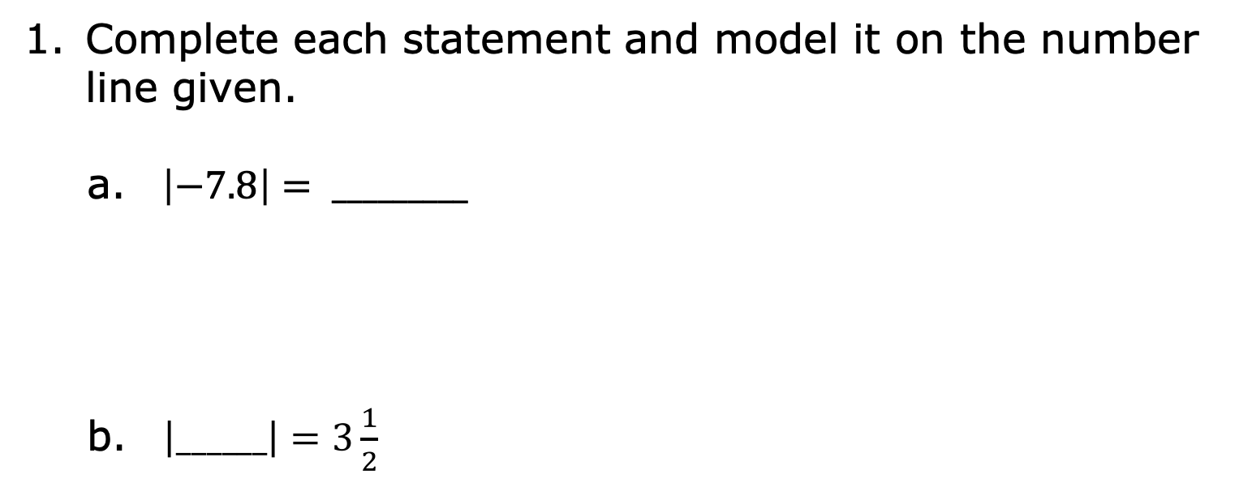
3.7.6 Your Turn!
Complete each statement and model it on the number line given.
$\left|−7.8\right|= _________$
$\left|______\right|=3\frac{1}{2}$
volume 1, pg. 116

Slide 27
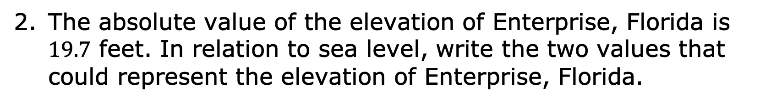
The absolute value of the elevation of Enterprise, Florida is $19.7$ feet. In relation to sea level, write the two values that could represent the elevation of Enterprise, Florida.
volume 1, pg. 116

Slide 28

Wrap-Up
volume 1, pg. 116

Slide 29
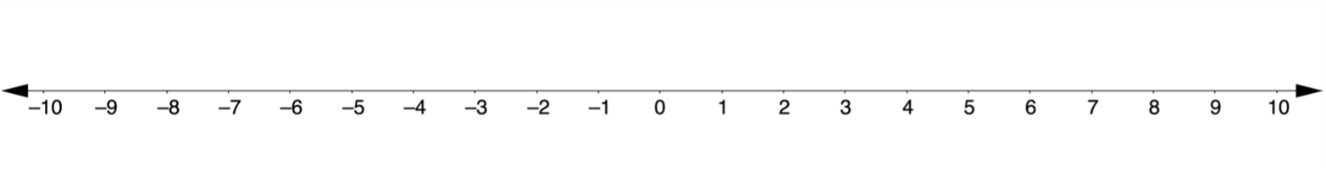
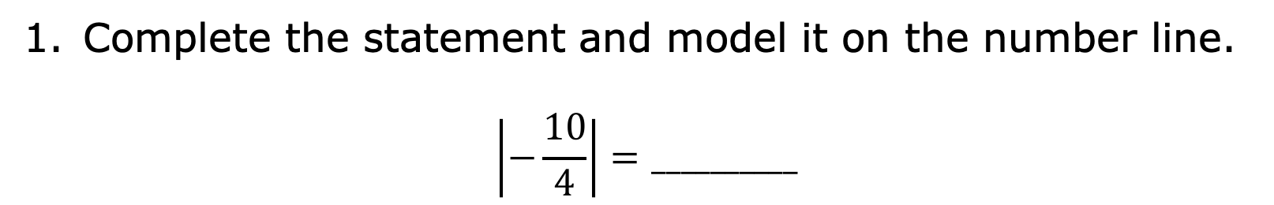
3.7.7 Wrap-Up: Ticket Out the Door
Complete the statement and model it on the number line.
$$\left|−\frac{10}{4}\right|=__________$$
volume 1, pg. 116

Slide 30
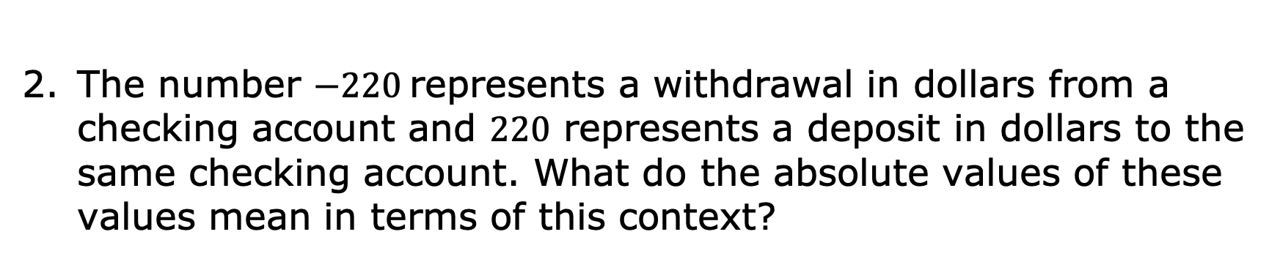
The number $−220$represents a withdrawal in dollars from a checking account and $220$ represents a deposit in dollars to the same checking account. What do the absolute values of these values mean in terms of this context?
volume 1, pg. 116

